Slide 1
Launch a Static Website on Amazon S3 Team: Cloud Commanders. Group Members: Preksha Deshmuckh Sai Madhuhas Kotini Satya Sri Dileep Kumar Damarla

Slide 2
Introduction
Launching RideUCM Website in S3 Bucket Using Python Boto3 Automation.
Amazon Web Services Used for this Project.
1.S3
2.CloudFront
3.Route 53
4.CloudWatch
5.Certificate Manager

Slide 3
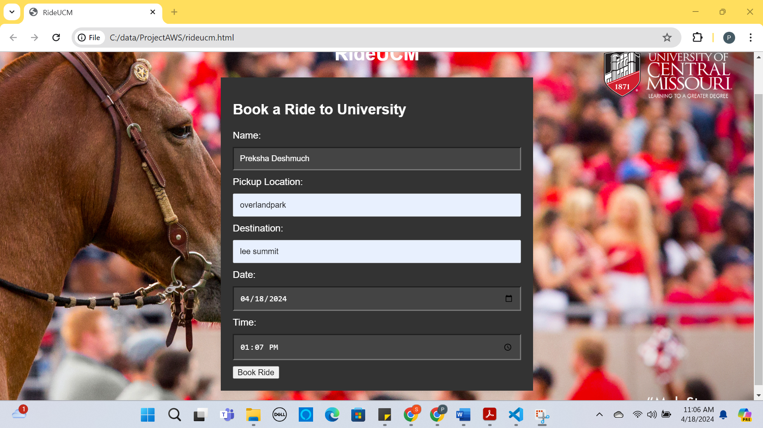
Webpage project -rideucm
Book a ride to the university is a user-friendly platform for booking a comfortable ride to the university at your convenience.
Its goal is to provide safe, comfortable, and affordable transportation for students.

Slide 4
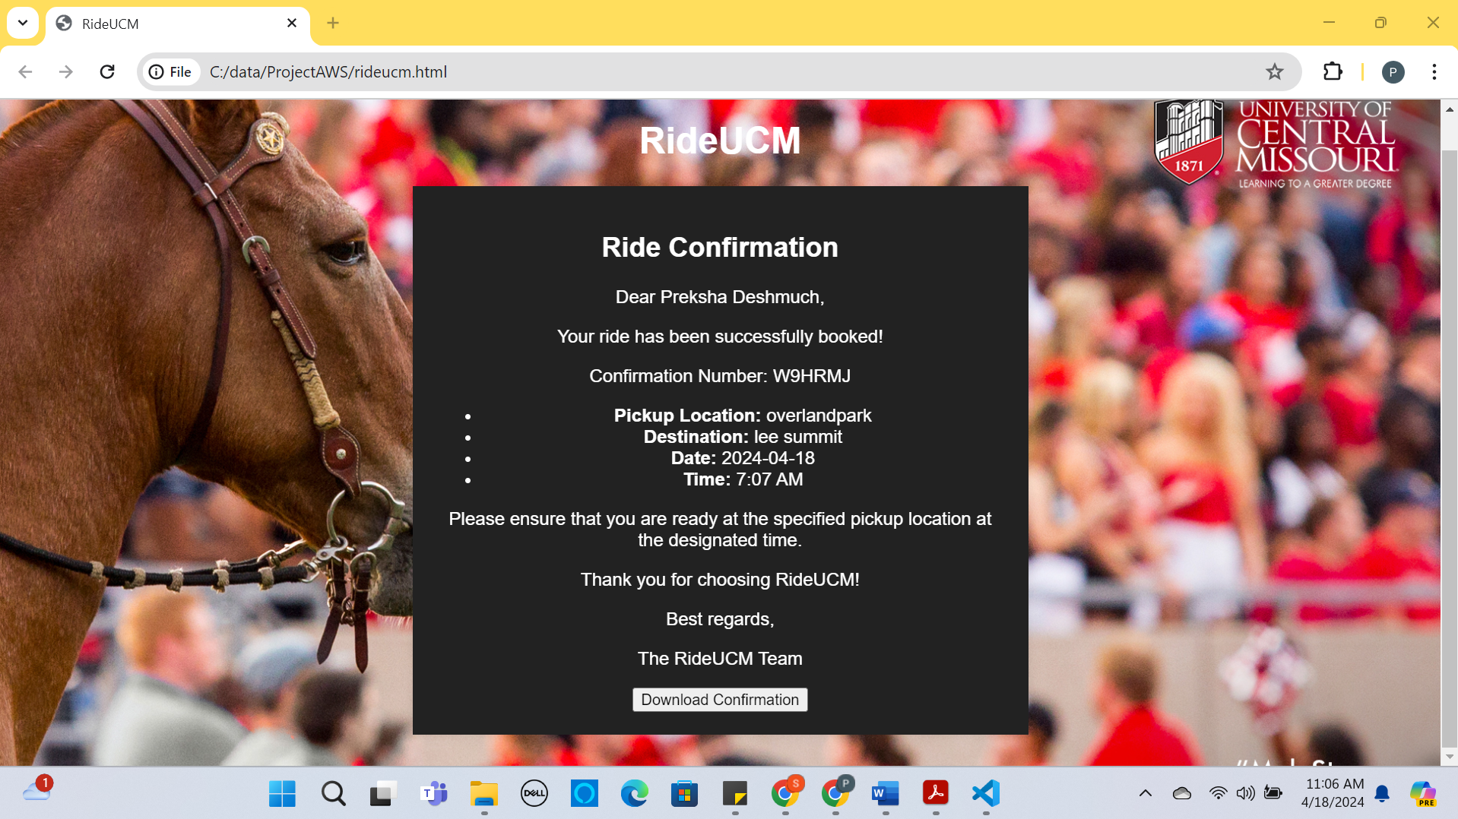
Webpage project -rideucm
When the user enters all the details on the webpage and clicks on the submit button(Book a ride). The ride details will be displayed on a different webpage with a download confirmation button.
Once the user clicks on the download confirmation button a text file with the ride details will download to the user's device.

Slide 5
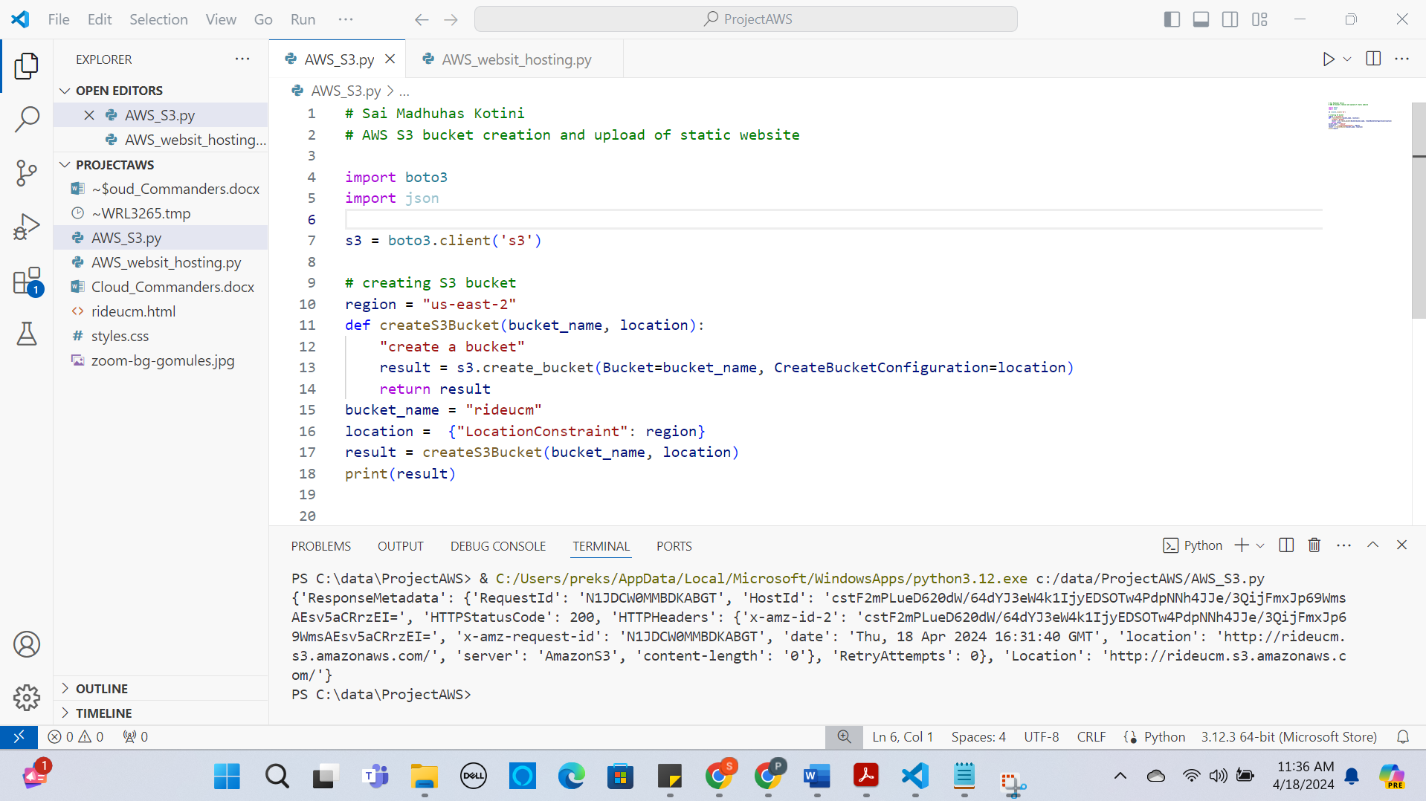
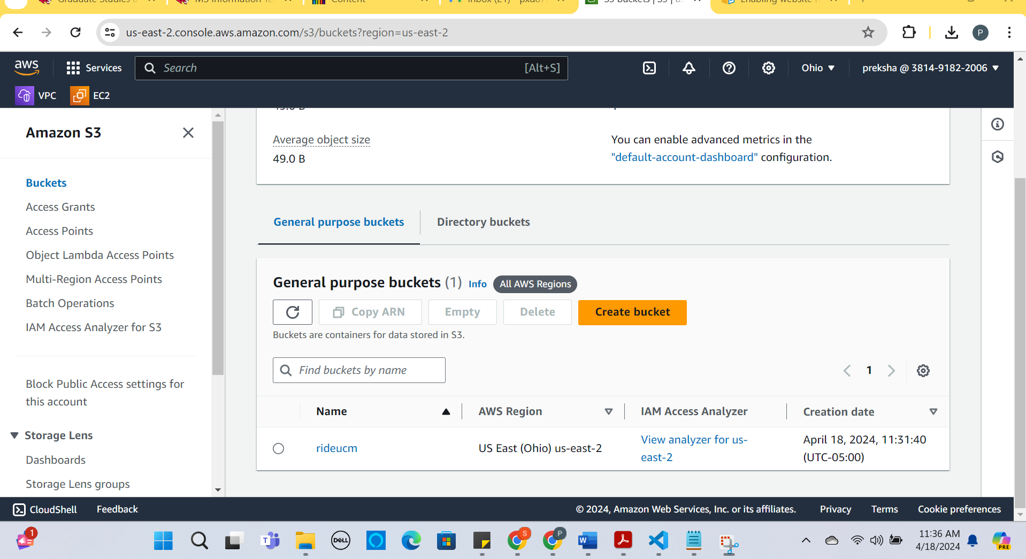
Launching a static website in S3 Bucket
Create a S3 Bucket name “rideucm” using Python Boto3.

Slide 6
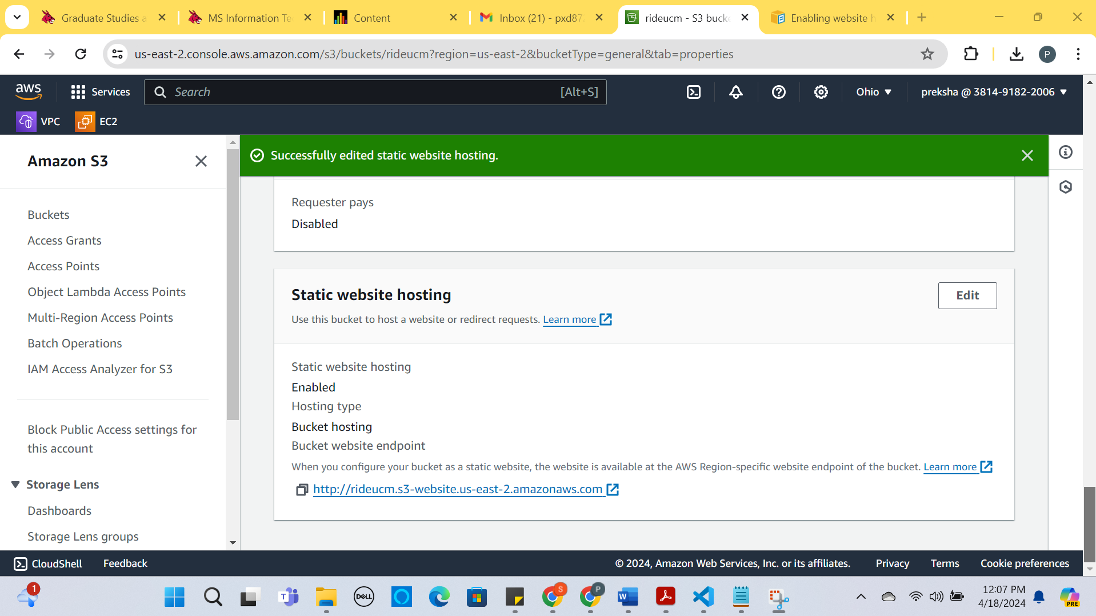
Enable Static Website Hosting through AWS console
Login to the AWS console with IAM user and password.
Goto the S3 Bucket dashboard.
Click on the S3 bucket “rideucm” which is created using python boto3.
Choose Properties.
In the Bucket overview under static website hosting click enable.
In the Bucket overview under static website hosting click enable.
In the Index document, enter the file name as the webpage name “index.html”.
Click on save changes.
EndPOint URL: http://rideucm.s3-website.us-east-2.amazonaws.com

Slide 7
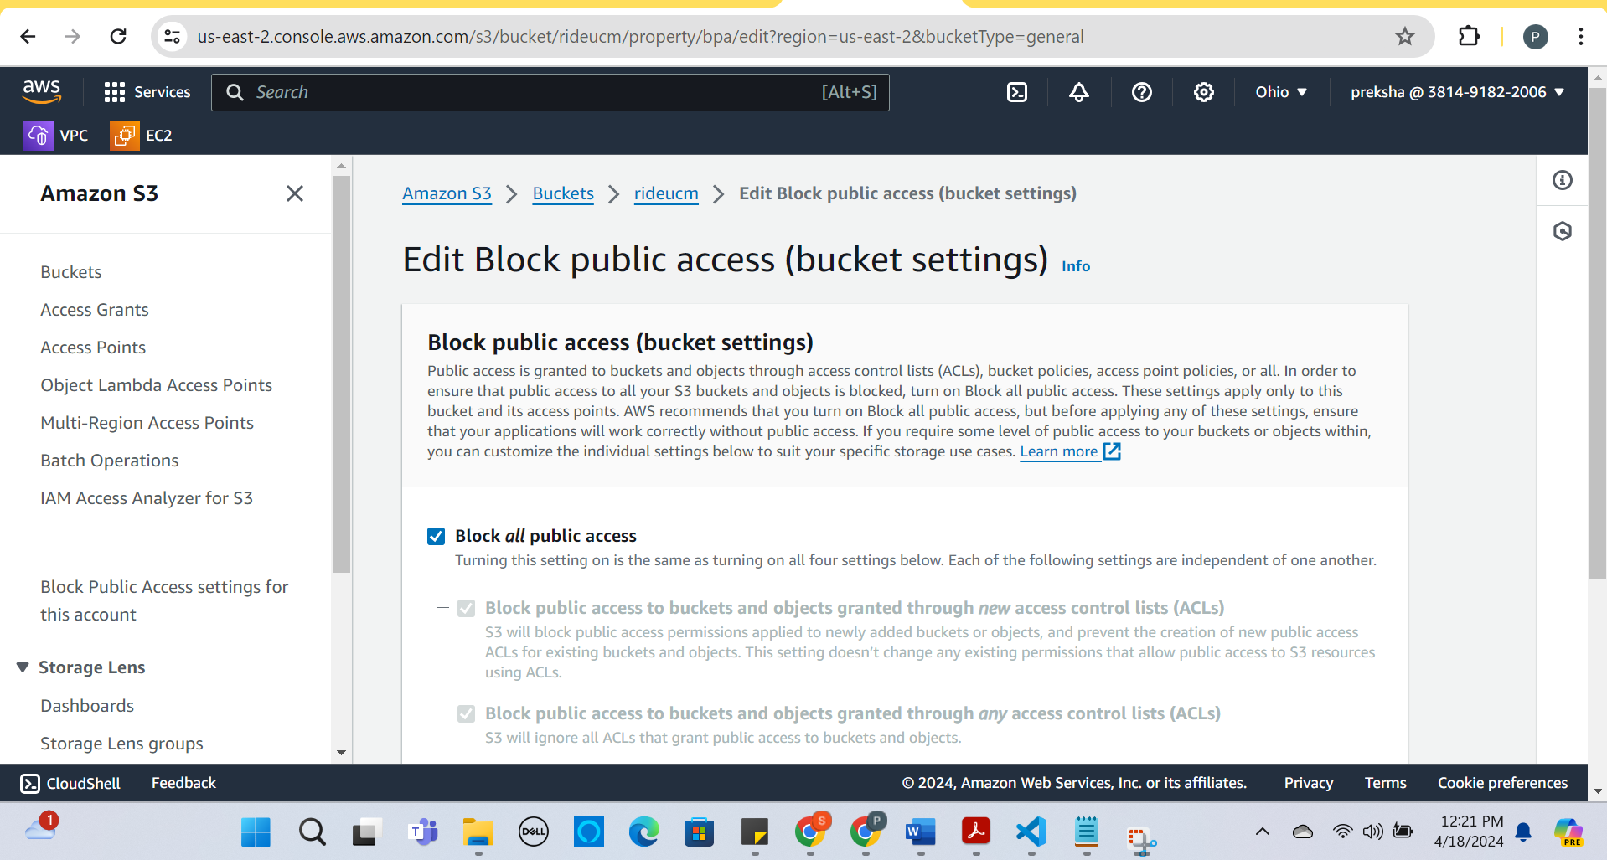
Enabling public access for the static website.
Login to the AWS console with IAM user and password.
Goto the S3 Bucket dashboard.
Click on the S3 bucket “rideucm” which is created using python boto3.
Click on the permission tab for the Bucket “rideucm”
Click on the Edit button for Block Public access settings by default it will be on.

Slide 8
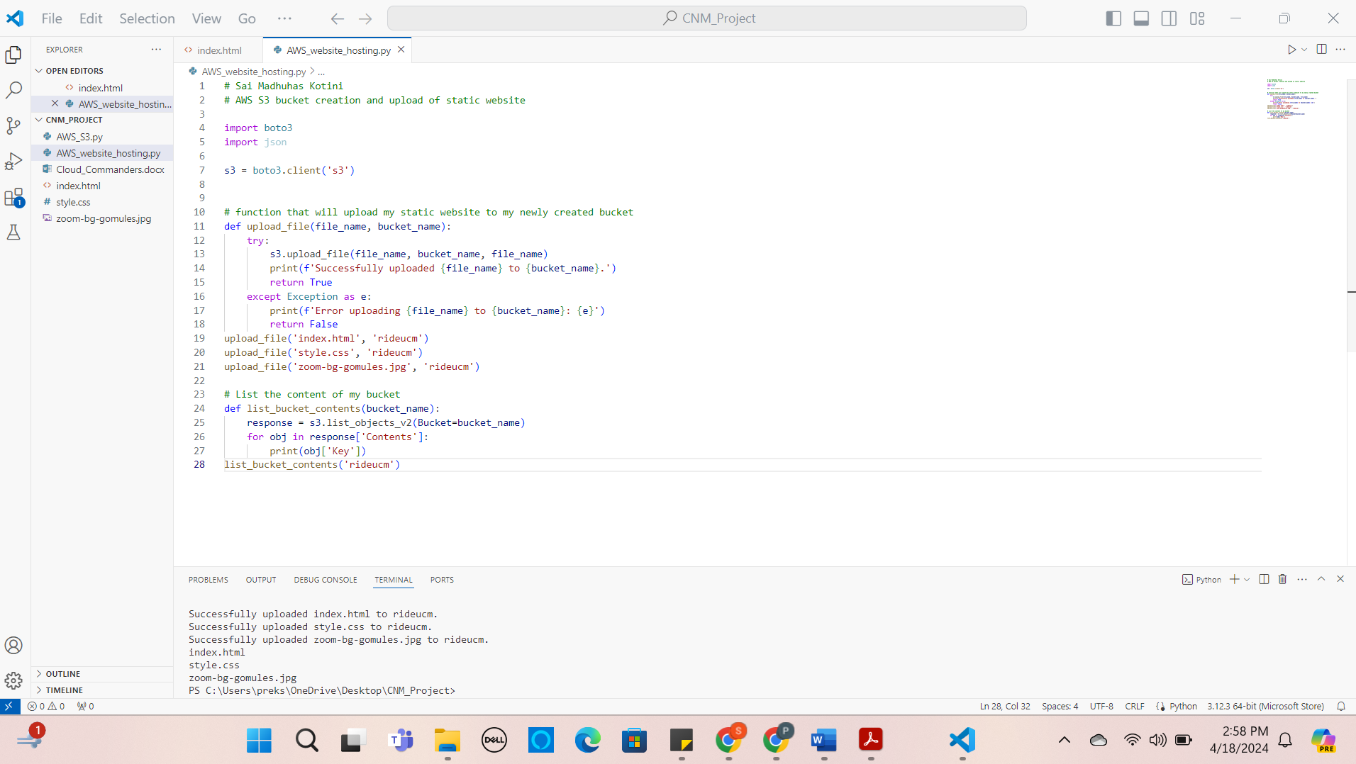
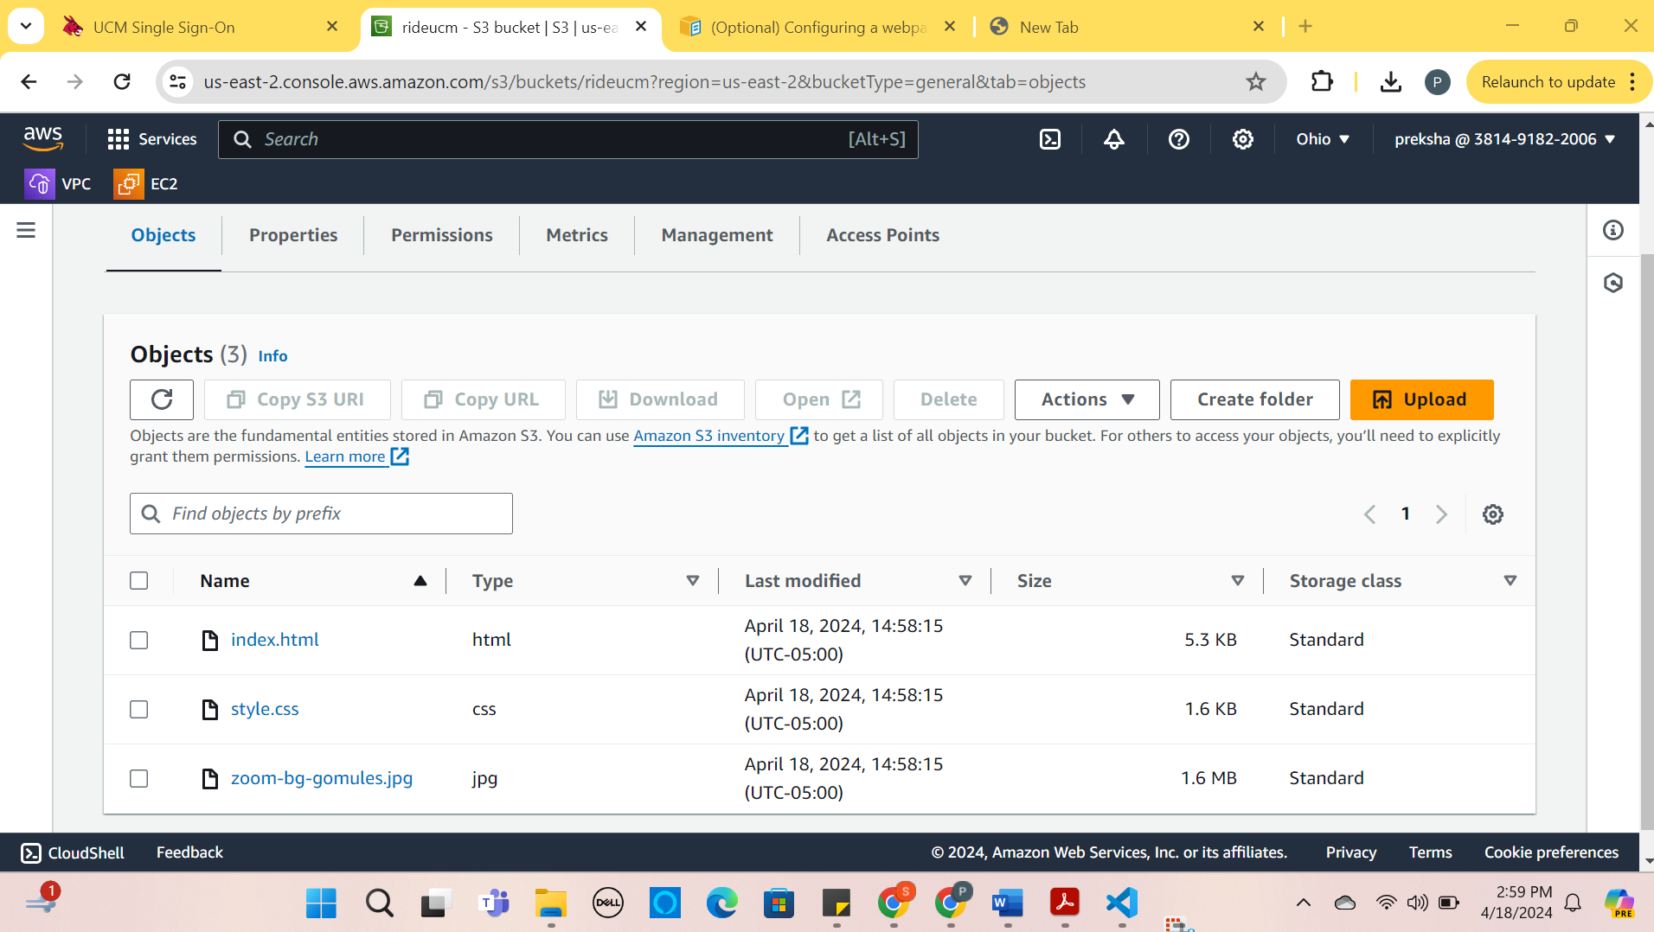
Upload the website(webpage) contents in the Se Bucket “rideucm” using Python Boto3.

Slide 9
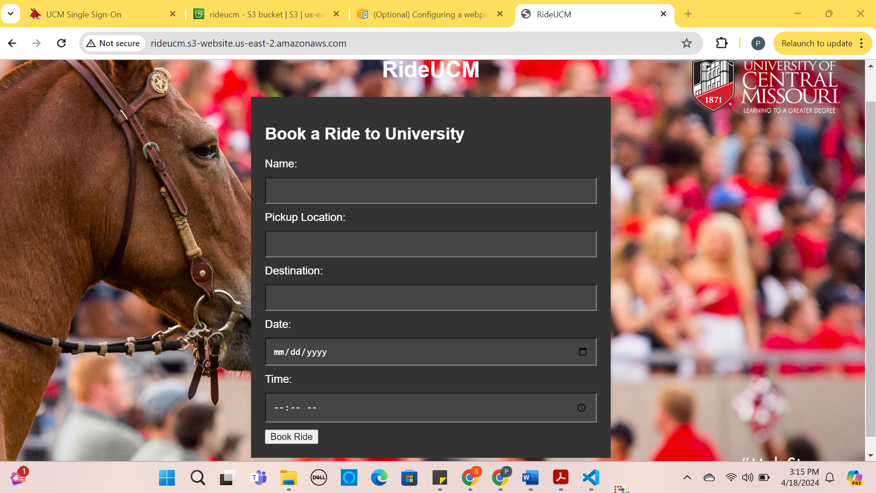
Access the static website using the endpoint url from S3
Click on the endpoint URL to access the website.
http://rideucm.s3-website.us-east-2.amazonaws.com/

Slide 10
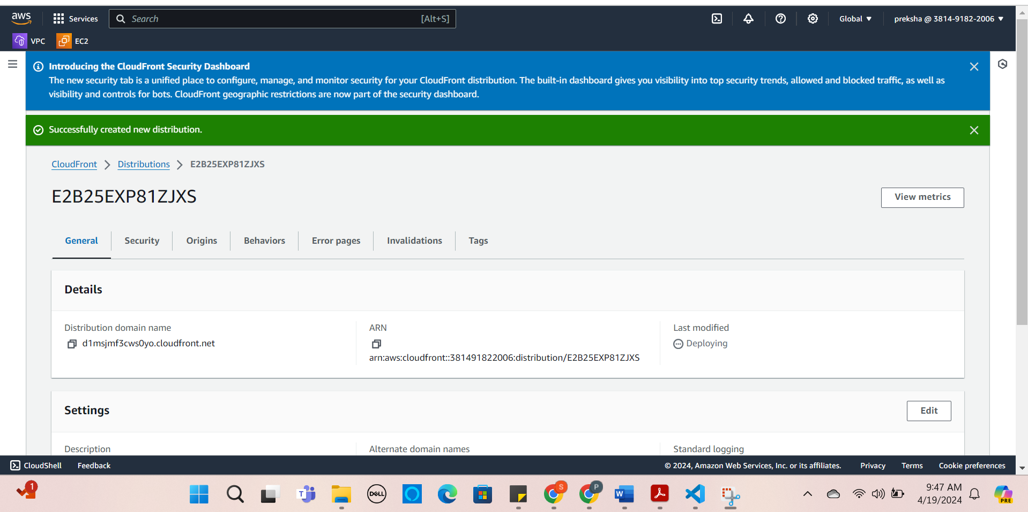
Using Amazon CloudFront distribution to launch our website globally:
Amazon CloudFront is a fast content delivery network (CDN) service that securely delivers data, videos, applications, and APIs to customers globally with low latency and high transfer speeds.
Continuous deployment can be done for any website in the CloudFront whenever a new content is added.

Slide 11
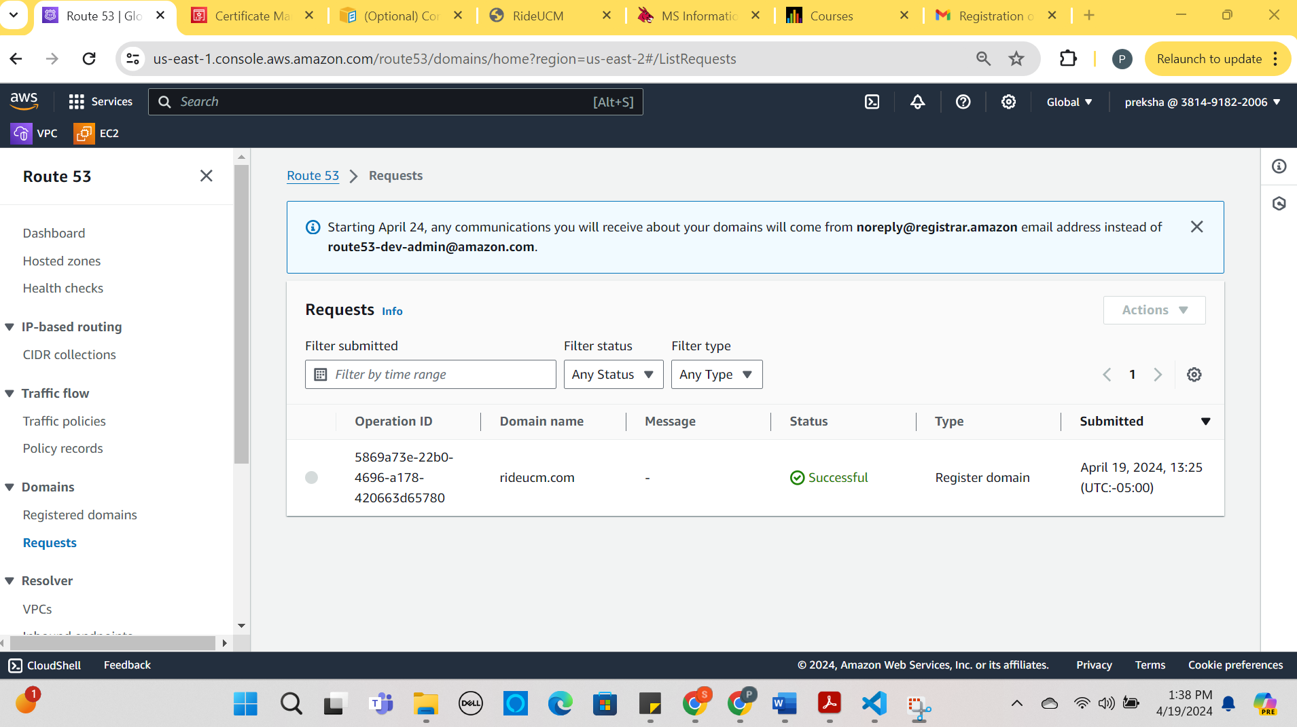
Creating a Domain name for the website using Amazon Route 53:
Amazon Route 53 can be used for DNS management, Traffic management, Availability monitoring, and Domain registration.
For our website we are registering the domain.
By giving FQDN for any website it is easy to access by an end user and easy to remember the name.

Slide 12
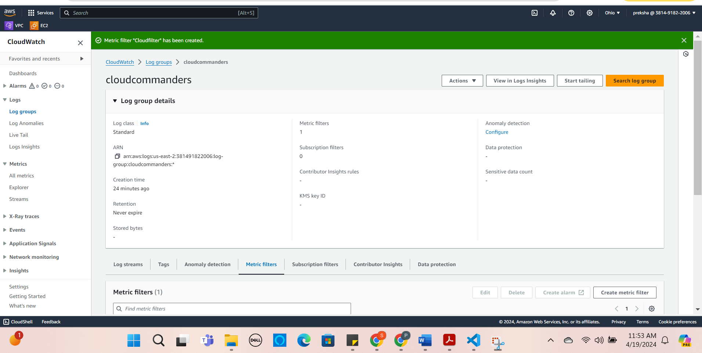
Creating Amazon CloudWatch for the website in the S3:
Amazon CloudWatch monitors your Amazon Web Services (AWS) resources and the applications you run on AWS in real-time. You can use CloudWatch to collect and track metrics, which are variables you can measure for your resources and applications.
For this website, we created Log streams, LogGroups, and metrics to monitor.

Slide 13
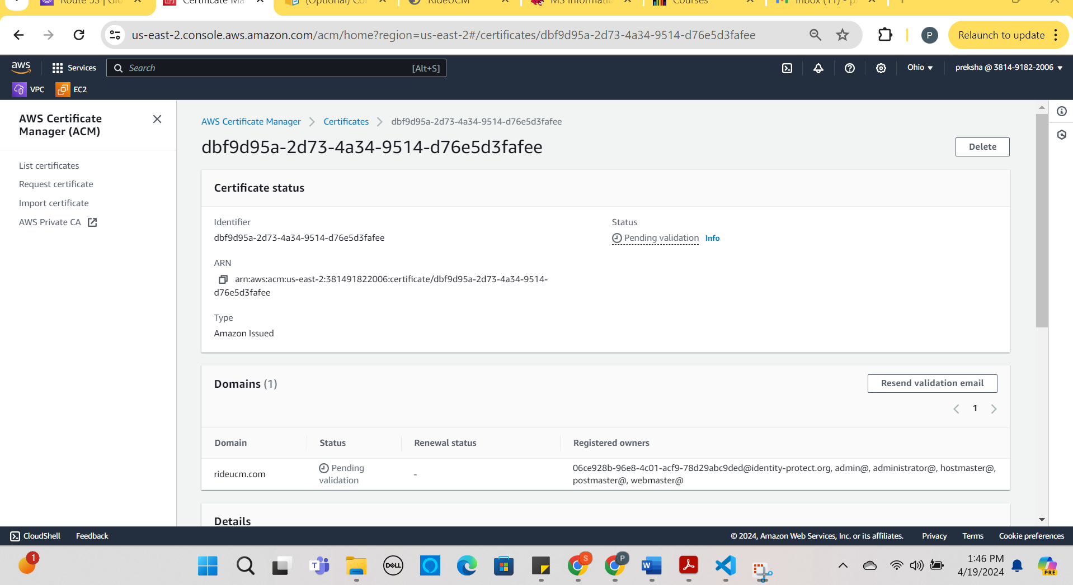
Setting Up the Amazon Certificate Manager for the static website Launched in S3 Bucket:
Request or import a TLS/SSL certificate you would like to use into your AWS account.
Validate domain ownership for your requested certificate using Domain Name System (DNS) or email validation to complete certificate issuance.
Use your newly issued or imported certificates in various AWS services like Elastic Load Balancing (ELB), Amazon CloudFront etc.

Slide 14
thank you

